Slide 1
Royal Mail Group

Slide 2
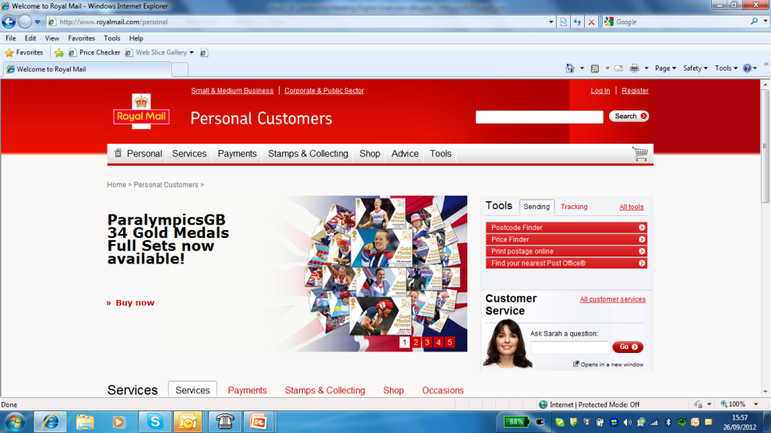
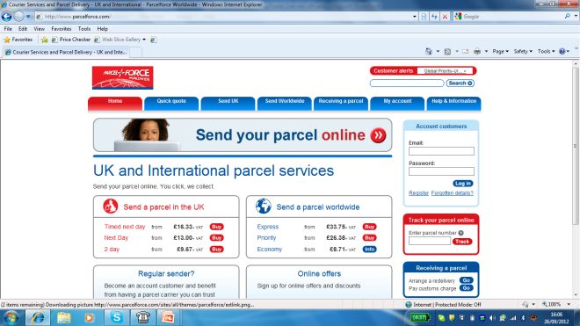
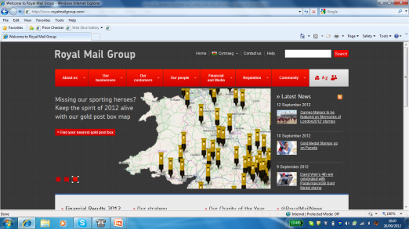
About Royal Mail Services
3 web sites and services
86 applications
Over 200 interfaces
25 external systems, e.g. Amazon
Ecosystem of 18 partners
6M registered users
20M+ unique visitors per month
50,000 ecommerce orders per day
£1.5Bn revenue supported
24x7x365 support
Very large Christmas peak
Ability to scale to meet point demands – e.g. Olympic Stamps
Agile delivery - ability to release new services every 4 weeks
Today

Slide 3


Capgemini proposed… “Immediate” Framework
Technology
SaaS and Opensource products first.
Re-usable framework for customer identity, integration and service management
Best of breed vendors managed in a single contract by Capgemini
Plug and play in line with business need
Managed service delivered to agreed SLA’s
Operating model covers incident management, service enhancement, application migration, user experience etc
Governance & Operation
A Technology Architecture
Capgemini Immediate
An Operating Model
A Commercial
Model
Commercial Model
Utility pricing aligned to business outcomes
Pay as you go to reduce upfront investment
Capgemini is at the forefront of digital enablement with Immediate

Slide 4











Royal Mail’s eBusiness Framework
Identity Management
Personalization and Interaction
Service Management
Content
Management
Personalization
Traffic Management
Collaboration
Search
Content
Management
Personalization
Traffic Management
Collaboration
Search
ID Management
Customer Management
Marketing
Access Management
Marketing
Data Warehouse
Customer transactions
Web analytics
Event Management
Customer
Transaction
Management
Traffic Management
Collaboration
Search
Customer
Transaction
Management
Service Integration
Service Support
Auditing Services
ETL
Interface Adapters
Reliable Messaging
File
Transfer
Workflow
Master Data Management
Process Orchestration
Content
Management
Interface Adapters
Publish Subscribe
Exception Management
Translation Transformation
Business Rules
Business Activity Management
Service Continuity
Encryption Services
Directory Services
Mail & Parcels Services
Information Aggregation
Supply Chain Services
Insurance Services
Financial Services
eRetail
Document Management
Government Services
Security Infrastructure
Archiving
Common Services
Credit Checking & Address Validation
Configurable Pricing
Common Shopping Basket & Payments
Anti-fraud
Printing
Content
Management
Personalization
Traffic Management
Collaboration
Search

Slide 5







Digital means…
Infinite access to information
e-Commerce a mature channel
Always on, anytime, anywhere
m-Commerce growing rapidly
Permanent connection with the community
Cloud based services are enabling the digital opportunity
The digital consumer drives outside-in transformation
The realisation of benefits can be weeks not years
One size doesn’t fit all local requirements
Digital means different thinking not different technology

Slide 6

Leveraging the power of Right Shore
UK
Release planning
Product planning
Infrastructure management
User Story discussions
Engagement Management
Estimation
Demo & Sprint review meetings
Offshore –India
Delivery Management
Test planning
Test Design
Life cycle testing
Metrics management
Training

Slide 7

Digital Testing specifics in RMG…
Skills
Web Testing, Web Services, Automation, Accessibility testing, Cross browser testing, Mobile testing, Content Management, Performance testing, eCommerce payment gateway (Datacash), Unix / SQL
Processes
Agile methodology, Sprints/Iteration,
Release management, LEAN
Technology
Drupal, PHP, Camel, Cordys, Behat-Automation, Cloud, Sales force, Open SSO
Notes:
© 2010 Capgemini – All rights reserved
7
© 2010 Capgemini – All rights reserved

Slide 8
Overview of Testing Services Offered
Functional Testing
Daily Smoke Test
Non-functional Testing
Performance Testing
Automation Testing
Behat Automation Testing
Regression Testing
JIRA- Defect /User Story based Testing
Skim Testing before Performance
Exploratory Testing
End to End Testing for eCommerce Applications
Live Support Test
Accessibility Testing
Cross Browser Testing
iPad Testing
Mobile Testing
Content Management System (CMS) Testing
Google Analytics
Omniture
Tealium
Selenium Automation
Gherkin Language user stories

Slide 9
Agile: Client Demand & Incident Prioritisation
Demand Source
Backlog
Sprint Scope
Major Project
100 RML-OLP DEAN
Error On Click
5
100 RML-OLP DEAN
Error On Click
5
Business Prioritisation
100 RML-OLP DEAN
Error On Click
5
100 RML-OLP DEAN
Error On Click
5
100 RML-OLP DEAN
Error On Click
5
100 RML-OLP DEAN
Error On Click
5
100 RML-OLP DEAN
Error On Click
5
100 RML-OLP DEAN
Error On Click
5
100 RML-OLP DEAN
Error On Click
5
100 RML-OLP DEAN
Error On Click
5
100 RML-OLP DEAN
Error On Click
5
100 RML-OLP DEAN
Error On Click
5
To Do
100 RML-OLP DEAN
Error On Click
5
100 RML-OLP DEAN
Error On Click
5
Business Enhancement
100 RML-OLP DEAN
Error On Click
5
100 RML-OLP DEAN
Error On Click
5
100 RML-OLP DEAN
Error On Click
5
100 RML-OLP DEAN
Error On Click
5
100 RML-OLP DEAN
Error On Click
5
100 RML-OLP DEAN
Error On Click
5
100 RML-OLP DEAN
Error On Click
5
100 RML-OLP DEAN
Error On Click
5
100 RML-OLP DEAN
Error On Click
5
100 RML-OLP DEAN
Error On Click
5
100 RML-OLP DEAN
Error On Click
5
100 RML-OLP DEAN
Error On Click
5
100 RML-OLP DEAN
Error On Click
5
100 RML-OLP DEAN
Error On Click
5
100 RML-OLP DEAN
Error On Click
5
100 RML-OLP DEAN
Error On Click
5
Sprint Planning
Small Change
100 RML-OLP DEAN
Error On Click
5
100 RML-OLP DEAN
Error On Click
5
100 RML-OLP DEAN
Error On Click
5
100 RML-OLP DEAN
Error On Click
5
100 RML-OLP DEAN
Error On Click
5
100 RML-OLP DEAN
Error On Click
5
100 RML-OLP DEAN
Error On Click
5
100 RML-OLP DEAN
Error On Click
5
100 RML-OLP DEAN
Error On Click
5
100 RML-OLP DEAN
Error On Click
5
100 RML-OLP DEAN
Error On Click
5
100 RML-OLP DEAN
Error On Click
5
100 RML-OLP DEAN
Error On Click
5
100 RML-OLP DEAN
Error On Click
5
100 RML-OLP DEAN
Error On Click
5
100 RML-OLP DEAN
Error On Click
5
100 RML-OLP DEAN
Error On Click
5
100 RML-OLP DEAN
Error On Click
5
100 RML-OLP DEAN
Error On Click
5
Defect*
100 RML-OLP DEAN
Error On Click
5
100 RML-OLP DEAN
Error On Click
5
100 RML-OLP DEAN
Error On Click
5
100 RML-OLP DEAN
Error On Click
5
100 RML-OLP DEAN
Error On Click
5
100 RML-OLP DEAN
Error On Click
5
100 RML-OLP DEAN
Error On Click
5
100 RML-OLP DEAN
Error On Click
5
100 RML-OLP DEAN
Error On Click
5
100 RML-OLP DEAN
Error On Click
5
100 RML-OLP DEAN
Error On Click
5
100 RML-OLP DEAN
Error On Click
5
100 RML-OLP DEAN
Error On Click
5
100 RML-OLP DEAN
Error On Click
5
100 RML-OLP DEAN
Error On Click
5
100 RML-OLP DEAN
Error On Click
5
100 RML-OLP DEAN
Error On Click
5
100 RML-OLP DEAN
Error On Click
5
Incident**
100 RML-OLP DEAN
Error On Click
5
100 RML-OLP DEAN
Error On Click
5
100 RML-OLP DEAN
Error On Click
5
100 RML-OLP DEAN
Error On Click
5
100 RML-OLP DEAN
Error On Click
5
100 RML-OLP DEAN
Error On Click
5
100 RML-OLP DEAN
Error On Click
5
100 RML-OLP DEAN
Error On Click
5
100 RML-OLP DEAN
Error On Click
5
100 RML-OLP DEAN
Error On Click
5
100 RML-OLP DEAN
Error On Click
5
100 RML-OLP DEAN
Error On Click
5
100 RML-OLP DEAN
Error On Click
5
100 RML-OLP DEAN
Error On Click
5
100 RML-OLP DEAN
Error On Click
5
100 RML-OLP DEAN
Error On Click
5
100 RML-OLP DEAN
Error On Click
5
100 RML-OLP DEAN
Error On Click
5
Service & Capgemini Prioritisation
100 RML-OLP DEAN
Error On Click
5
100 RML-OLP DEAN
Error On Click
5
100 RML-OLP DEAN
Error On Click
5
100 RML-OLP DEAN
Error On Click
5
100 RML-OLP DEAN
Error On Click
5
100 RML-OLP DEAN
Error On Click
5
100 RML-OLP DEAN
Error On Click
5
100 RML-OLP DEAN
Error On Click
5
100 RML-OLP DEAN
Error On Click
5
100 RML-OLP DEAN
Error On Click
5
100 RML-OLP DEAN
Error On Click
5
100 RML-OLP DEAN
Error On Click
5
Technical Improvement
100 RML-OLP DEAN
Error On Click
5
100 RML-OLP DEAN
Error On Click
5
100 RML-OLP DEAN
Error On Click
5
100 RML-OLP DEAN
Error On Click
5
100 RML-OLP DEAN
Error On Click
5
100 RML-OLP DEAN
Error On Click
5

Slide 10

Testing Iteration Lifecycle
Understand Change
Regression Test
Daily Smoke Test
Impact Analysis
Write/Update TC’s
Skim Test
Daily Behat Smoke
Execute on different Browsers
Test Steps and Evidences
Live Support Test
User Story Test
Test Result Review
Pass/Fail only after Review
PVT Test
End to End Test
Raised Defect with all info
Follow above on QT environment

Slide 11
Continuous Integration with Jenkins

Slide 12
Success Stories
Olympics and Paralympics Stamps in London, 2012
Royal Mail produced the Commemorative stamps celebrating British Team victories within 24 hours. Previously we had a 24-month turnaround with a new set of stamps and we were already working on designs for 2014. With the Olympics the fastest turnaround we did was just 11 hours. Royal Mail had made stamps available within 24 hours; many Post Offices opened on Sunday to ensure stamps marking Saturday Gold's could be sold the next day
Website Redesign Awards 2013
Web User Magazine: “The new site combines a simple and stylish layout with one click access to the Royal Mails' most useful services… first-class effort all round. Our Rating *****”
Pocket-lint.co.uk: “The new first class post…They’ve made this look and feel like a site worthy of one of the most remarkable services we have in the UK.”

Slide 13
Thank You

